Slide 1
Genes and Genetic Information

Slide 2
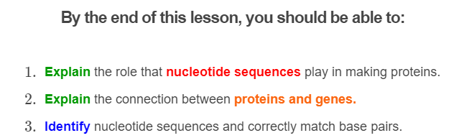
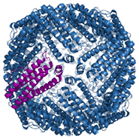

Slide 3
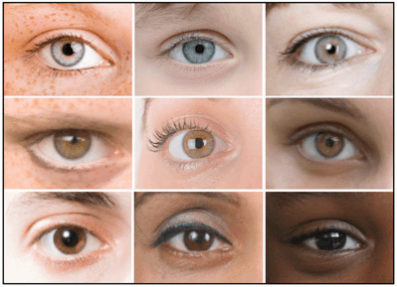
DNA is a molecule that stores information about your characteristics and traits.
Characteristics are things like your eye colour, blood type or height, while traits are the form that characteristic takes.
So your DNA is what determines whether you have brown or blue eyes, or whether your blood type is A positive or B negative.

Slide 4
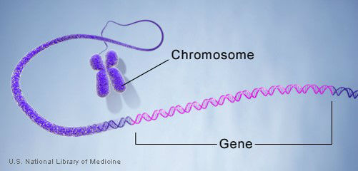
The information in your DNA is stored in genes.
Genes are lengths of DNA, strung one after another like words in a sentence.
You have over 20,000 genes in your DNA!

Slide 5

Different genes contain information for different characteristics.
One gene may contain information which controls your eye colour, and another may contain information about your hair colour.

Slide 6
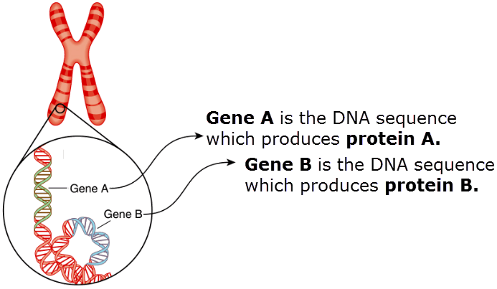
Genes control your traits by coding for proteins.
Coding means they contain the information required to make that protein. Think of genes as recipes for proteins.

Slide 7
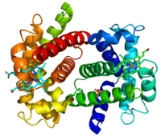
Proteins are little molecules that perform functions.
For example, some proteins will deposit pigment (coloured material) in your eyes, hair and skin. These proteins thereby control your eye, hair and skin colour.
You can think of proteins as the tools and machinery of your cells.

Slide 8


Slide 9
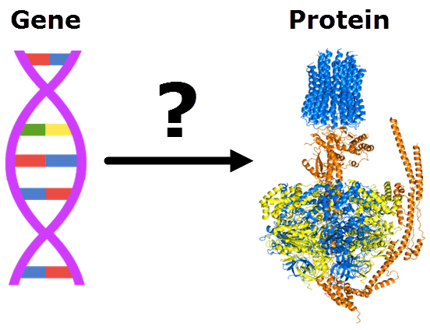
So now you know that genes code for proteins and these proteins control your traits.
But how do genes carry the information for making proteins?

Slide 10
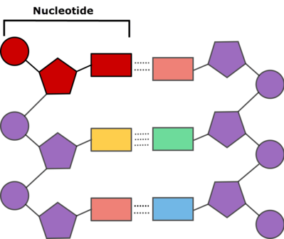
Genes contain this information in their nucleotides.
Remember, nucleotides are the building blocks of DNA, made from a sugar, phosphate and a nitrogenous base.
There are four types, depending on which nitrogenous base they have:
adenine (A), thymine (T), guanine (G) and cytosine (C).

Slide 11
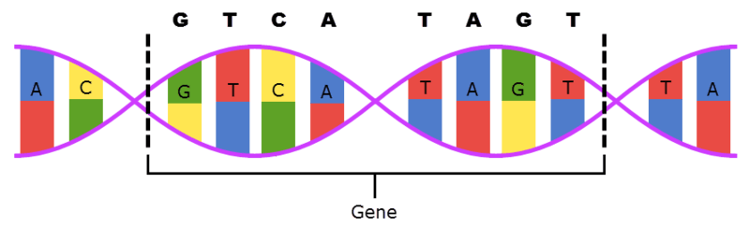
Genes, being lengths of DNA, are made from a series of nucleotides.
The order and number of these nucleotides makes a gene's nucleotide sequence.
For example, the gene below has the nucleotide sequence GTCATAGT.
(G = guanine, T = thymine, A = adenine, C = cytosine)

Slide 12
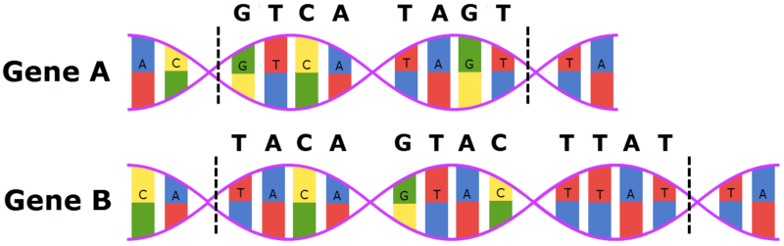
It is the nucleotide sequence of a gene that stores information.
When a gene codes for a protein, it is the order of the nucleotides that determines which protein that gene makes.
So if one gene has the sequence GTCATAGT and another TACAGTACTTAT, the two genes will code for different proteins.

Slide 13
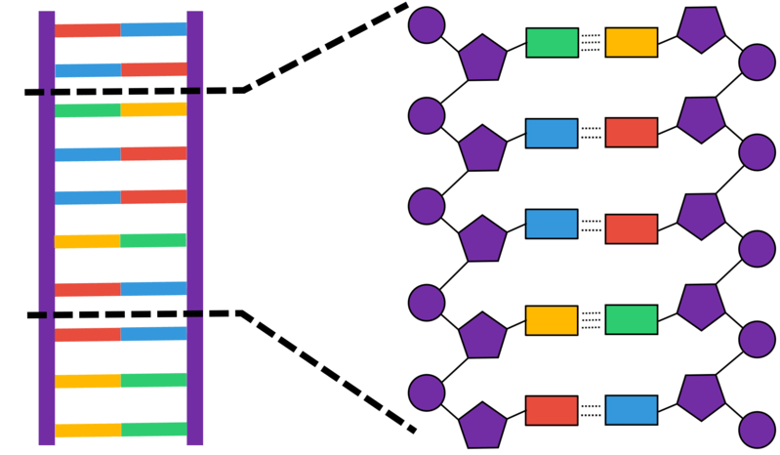
In short, you can think of nucleotides as letters and a gene's nucleotide sequence as a word.
If you change the order of the letters, you will change the meaning of the word. This changes the information stored in a gene, making it produce a different protein.

